Slide 1

Agriculture and hot temperatures interactively erode the nest success of habitat generalist birds across the United States
Report person：2251745 张宇
Report time：2023.12.18

Slide 2

Background
Birds may be particularly sensitive to temperature extremes, because species with altricial young are ectothermic for the first few weeks of life, and extreme temperatures can divert energy from growth to thermoregulation . Recent work suggests that high temperatures can also reduce avian survival and even cause community collapse. Temperature extremes may limit species persistence more than long-term increases in average temperatures, and variations in microclimate buffering can thus influence bird distributions .
Project NestWatch, a citizen-science nest-monitoring program organized by the Cornell Laboratory of Ornithology, offers a rare opportunity to explore how temperature extremes and land use interact to affect avian nesting success at a national scale. Using their data, we analyzed 152,863 nesting attempts by 58 bird species across 23 years (1998 to 2020) and 37,869 sites in four land-use types within the conterminous US: forests, open natural habitats, agricultural settings, and developed areas.

Slide 3
The work was guided by four questions.
A. temperature
C. species’ ranges
How do the effects of temperature on nesting success vary across land-cover types?
Are the effects of temperature and land cover consistent across species’ ranges?
Four
Questions
D. looking forward
B. compare
Are some species more vulnerable to the interactive effects of habitat conversion and climate change than others?
Looking forward across the 21st century, how will nesting success likely change across space, time, and alternative climate change scenarios?

Slide 4
Research methods for the above issues.
A. temperature
B. compare
We hypothesized that maximum temperature anomalies would reduce success in open, human-dominated habitats with fewer thermally buffered areas. We also quantified precipitation anomalies during nesting, hypothesizing that extreme events would also reduce success in open, human-dominated habitats.
We predicted that species that build exposed nests (as opposed to cavity nests) and species of higher conservation concern would be the most sensitive to climate and land-use interactions.

Slide 5
Research methods for the above issues.
C. species’ ranges
D. looking forward
We predicted that maximum temperature anomalies would disproportionately affect nesting success in agricultural areas within warmer regions.
We hypothesized that declines would be pronounced in agricultural settings, grassland, and developed areas, but not in forests.

Slide 6
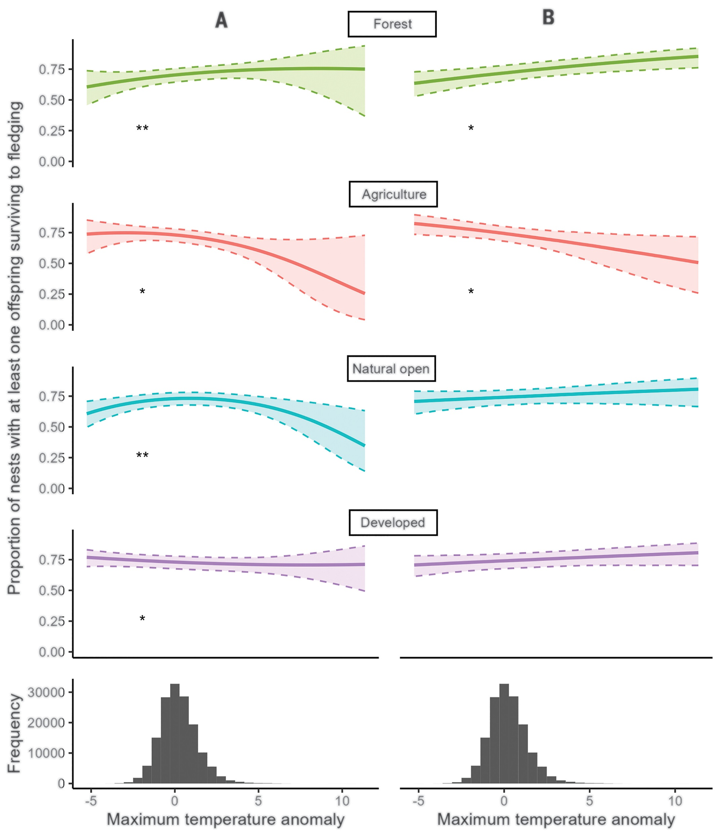
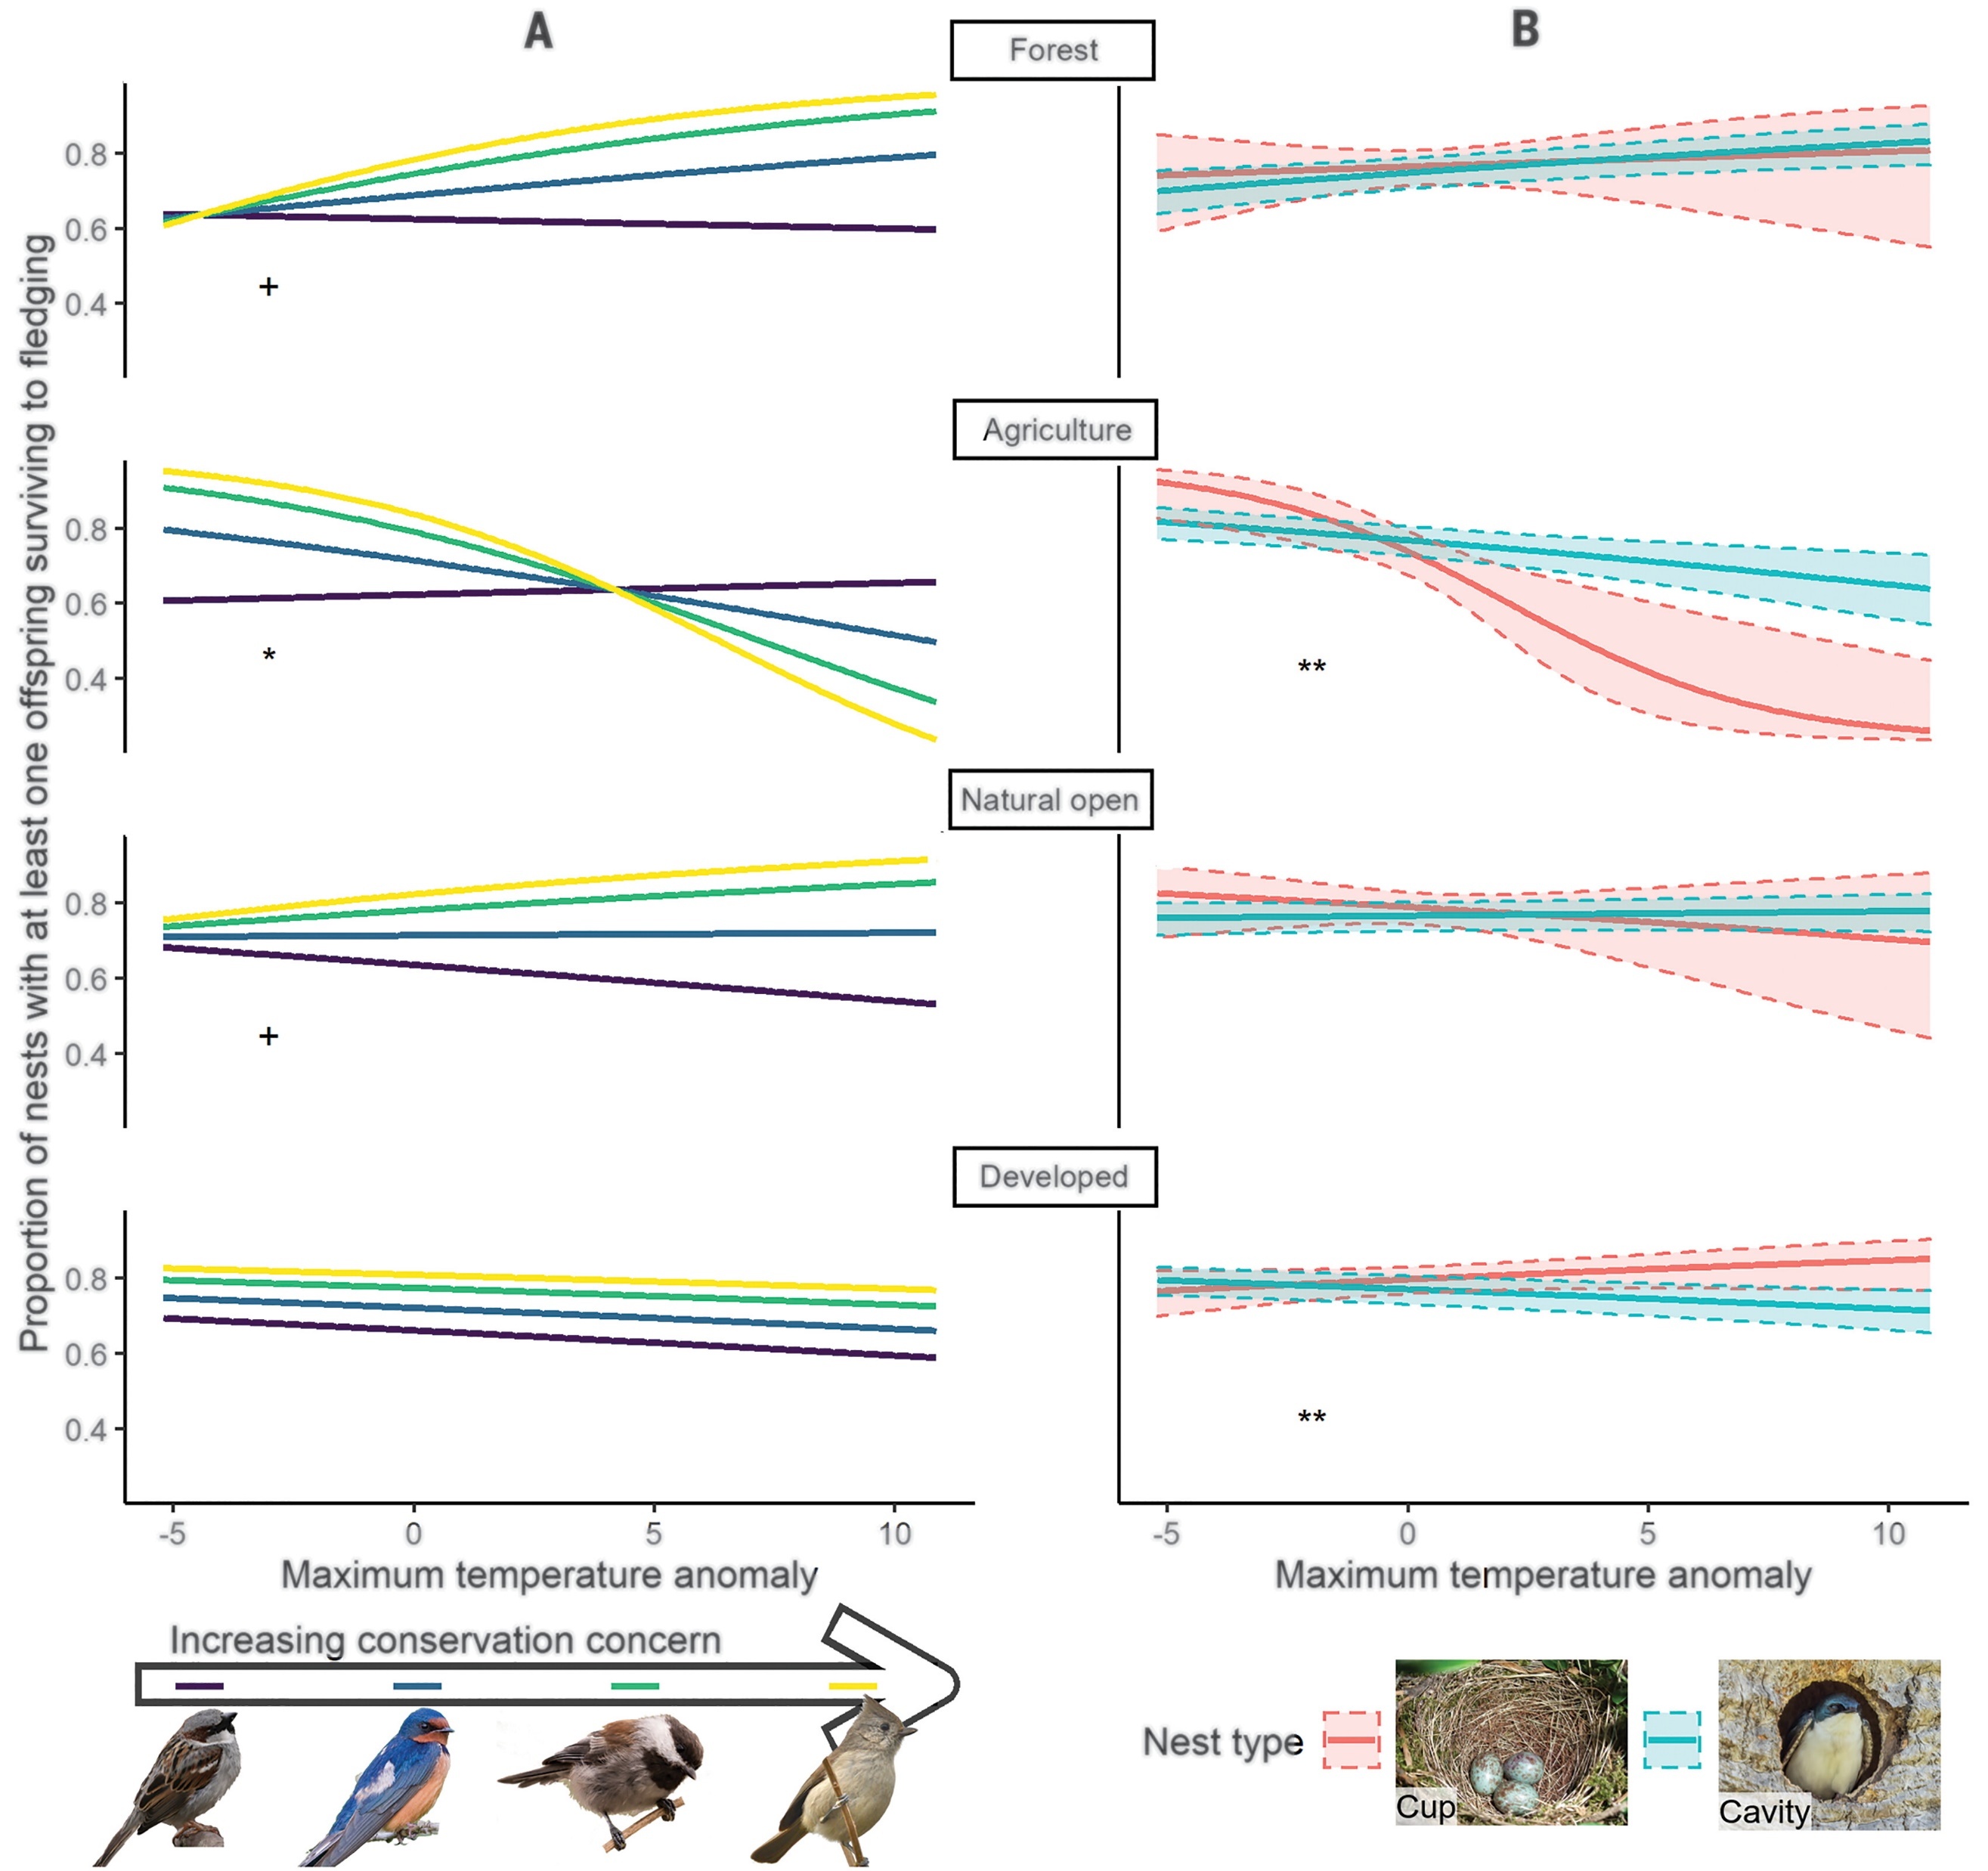
Findings

Slide 7
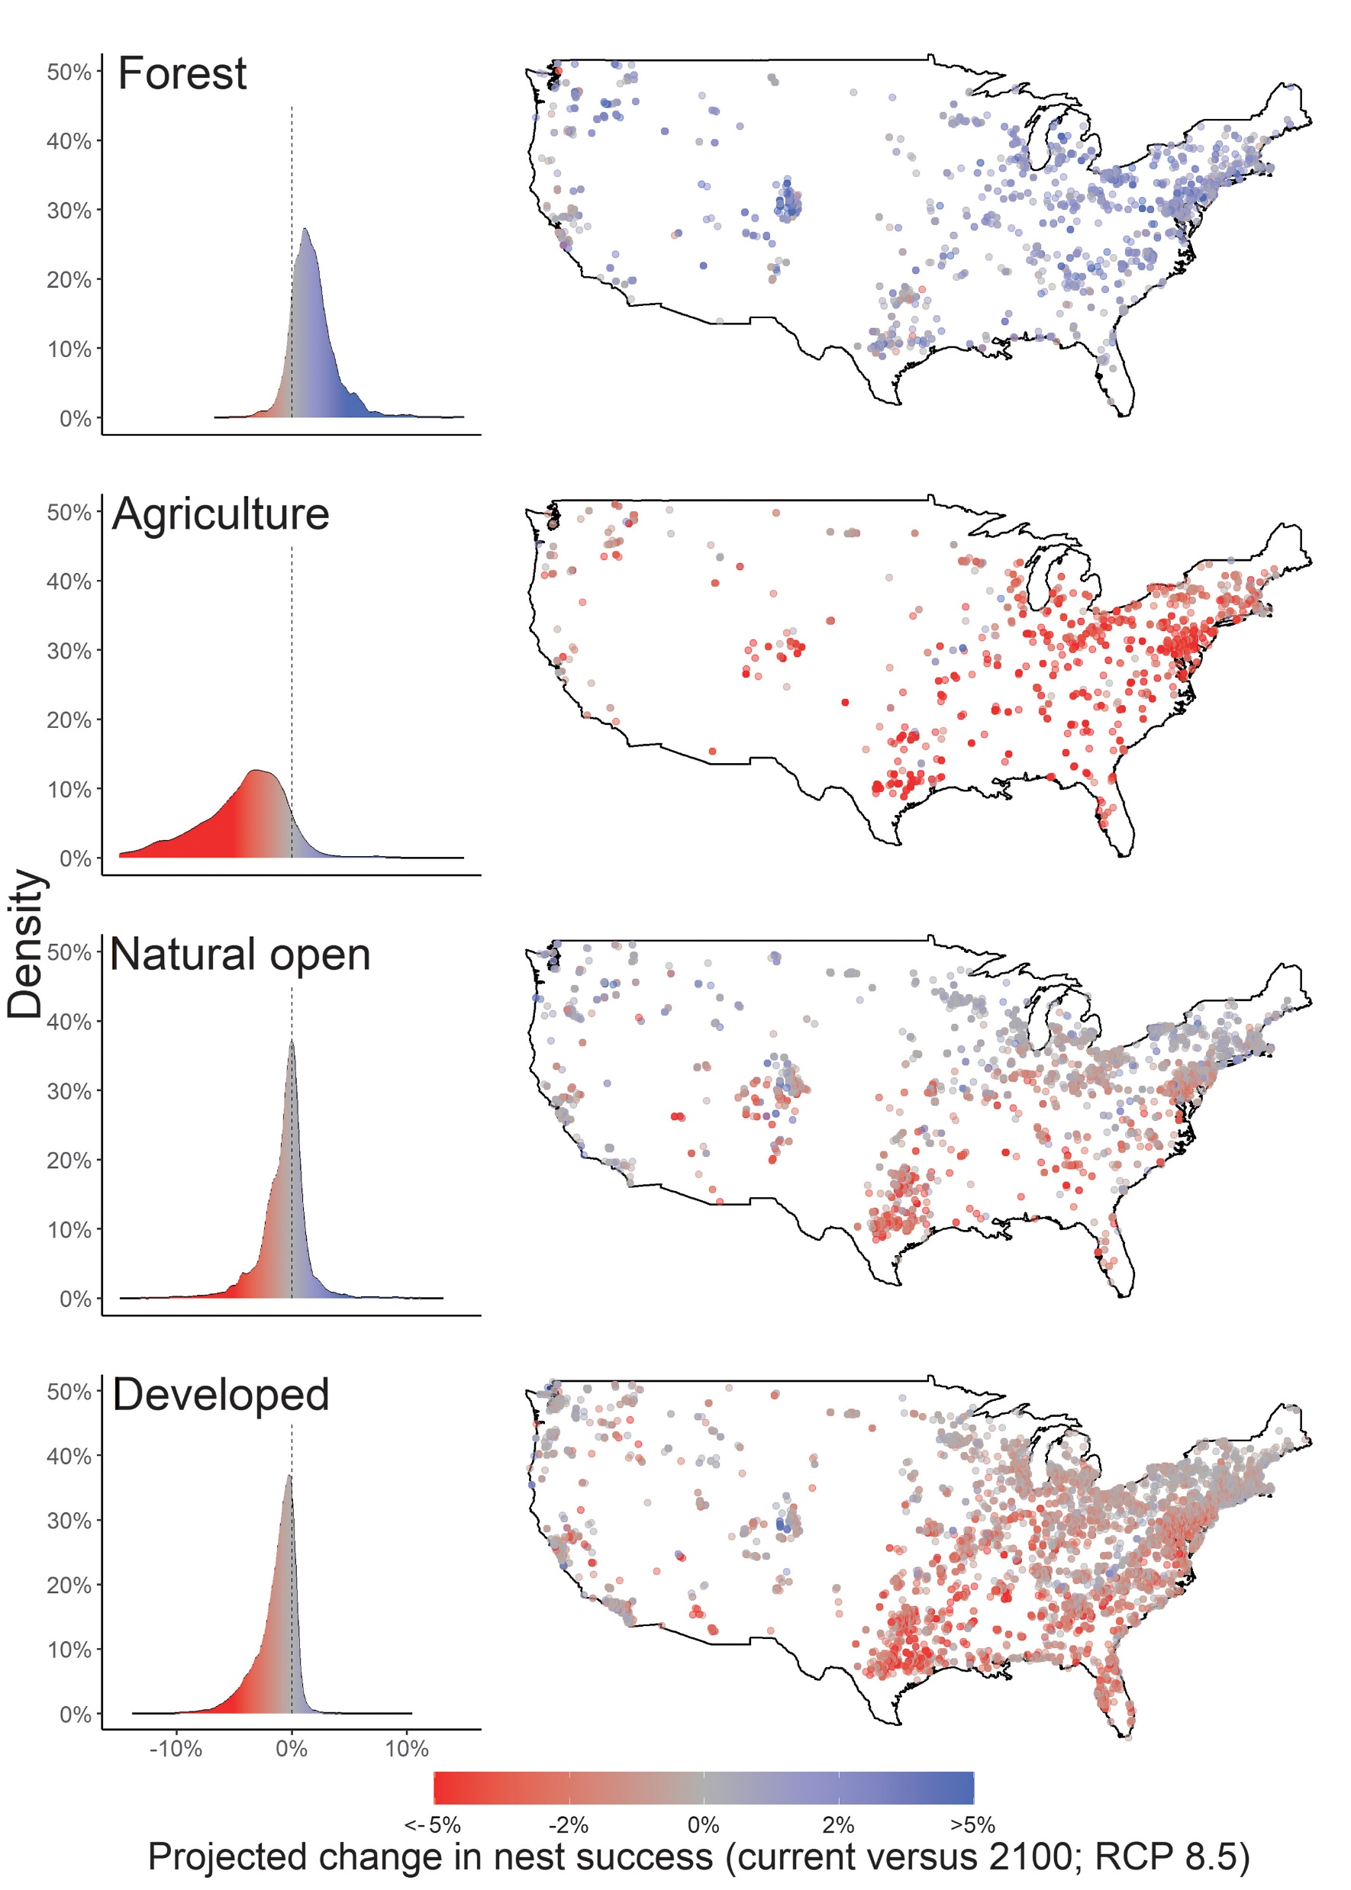
Findings and references
1、R. Dirzo, P. H. Raven, Global state of biodiversity and loss. Annu. Rev. Environ. Resour. 28, 137–167 (2003).2
2、F. E. B. Spooner, R. G. Pearson, R. Freeman, Rapid warming is associated with population decline among terrestrial birds and mammals globally. Glob. Chang. Biol. 24, 4521–4531 (2018).3
3、T. H. Oliver, M. D. Morecroft, Interactions between climate change and land use change on biodiversity: Attribution problems, risks, and opportunities. Wiley Interdiscip. Rev. Clim. Change 5, 317–335 (2014).
4、J. J. Williams, T. Newbold, Local climatic changes affect biodiversity responses to land use: A review. Divers. Distrib. 26, 76–92 (2020).5
5、R. A. Senior, J. K. Hill, P. González Del Pliego, L. K. Goode, D. P. Edwards, A pantropical analysis of the impacts of forest degradation and conversion on local temperature. Ecol. Evol. 7, 7897–7908 (2017).6
6、D. R. Garrett, F. Pelletier, D. Garant, M. Bélisle, Combined influence of food availability and agricultural intensification on a declining aerial insectivore. Ecol. Monogr. 92, e1518 (2022).7
7、C. Kremen, A. M. Merenlender, Landscapes that work for biodiversity and people. Science 362, eaau6020 (2018).
8、J. C. Wingfield, J. H. Pérez, J. S. Krause, K. R. Word, P. L. González-Gómez, S. Lisovski, H. E. Chmura, How birds cope physiologically and behaviourally with extreme climatic events. Philos. Trans. R. Soc. Lond. B Biol. Sci. 372, 20160140 (2017).
9、D. W. Winkler, M. K. Luo, E. Rakhimberdiev, Temperature effects on food supply and chick mortality in tree swallows (Tachycineta bicolor). Oecologia 173, 129–138 (2013).
10、J. R. Shipley, C. W. Twining, C. C. Taff, M. N. Vitousek, A. Flack, D. W. Winkler, Birds advancing lay dates with warming springs face greater risk of chick mortality. Proc. Natl. Acad. Sci. U.S.A. 117, 25590–25594 (2020).
11、B. Zuckerberg, C. A. Ribic, L. A. McCauley, Effects of temperature and precipitation on grassland bird nesting success as mediated by patch size. Conserv. Biol. 32, 872–882 (2018).
12、A. R. Bourne, S. J. Cunningham, C. N. Spottiswoode, A. R. Ridley, High temperatures drive offspring mortality in a cooperatively breeding bird. Proc. Biol. Sci. 287, 20201140 (2020).
13、E. A. Riddell, K. J. Iknayan, B. O. Wolf, B. Sinervo, S. R. Beissinger, Cooling requirements fueled the collapse of a desert bird community from climate change. Proc. Natl. Acad. Sci. U.S.A. 116, 21609–21615 (2019).
14、N. E. Zimmermann, N. G. Yoccoz, T. C. Edwards Jr., E. S. Meier, W. Thuiller, A. Guisan, D. R. Schmatz, P. B. Pearman, Climatic extremes improve predictions of spatial patterns of tree species. Proc. Natl. Acad. Sci. U.S.A. 106, 19723–19728 (2009).
15、S. J. K. Frey, A. S. Hadley, M. G. Betts, Microclimate predicts within-season distribution dynamics of montane forest birds. Divers. Distrib. 22, 944–959 (2016).
16、J. M. Northrup, J. W. Rivers, Z. Yang, M. G. Betts, Synergistic effects of climate and land-use change influence broad-scale avian population declines. Glob. Chang. Biol. 25, 1561–1575 (2019).
17、Materials and methods are available as supplementary materials.18
18、J. T. Abatzoglou, Development of gridded surface meteorological data for ecological applications and modelling. Int. J. Climatol. 33, 121–131 (2013).
…………

